Slide 1
CYCLIST BICYCLE SHARE CASE STUDY
An analysis into how a bicycle-share business can navigate a speedy success.

Slide 2
Hello! I’m...
Abdullahi Mohammed Ahmed.
I am a Data Analyst with about 2 years cognate experience helping organizations make sense out of their data and deriving impactful insights geared towards attaining the organizational goals.
Github Project Link:
My LinkedIn : www.https://linkedin.com/in/abdulahmedm
Email: abdullahiahmedm@yahoo.com
Tableau Dashboard

Slide 3
01 – Problem Statement
02 – About the Data
03 – Processing the Data
04 - Findings
05 - Conclusions
06 – Appendix
Table of contents

Slide 4
PROBLEM STATEMENT
HOW DO ANNUAL AND CASUAL MEMBERS USE BIKE-SHARE DIFFERENTLY
Cyclistic has two types of riders, casual riders who purchase single-ride passes or full-day passes and annual members who have an annual membership subscription.
Finance team are convinced that annual members are more profitable.
Marketing team is tasked with developing a marketing strategy to target casual members to convert them to annual members.

Slide 5
As the Data analyst, the task is finding out “How Annual and Casual members use Cyclistic bike share differently”.
PROBLEM STATEMENT

Slide 6
ABOUT THE DATA
Data for this project was domiciled in this Link here
Data is grouped by month and stored in zip files
There are no issues regarding the credibility and bias of the data as contained in its license
There were no issues observed with the data regarding ROCCC ie data was found to be Reliable, Original, Comprehensive, Current and Cited.

Slide 7
PROCESSING THE DATA
Tools used included Microsoft SQL Server, Microsoft Excel and Tableau.
The various zip files representing 12 months of bike rides was downloaded and the csv files were unzipped.
These csv files were now imported into SQL server where I created a database and each months data was imported into a tables representing each month.
After the import, I created a new table using “Select into” containing all records from all the imported data.
Six (6) new columns were created
Route column
Trip_len column
Weekday column
Month column
MonthName column
Quarter column

Slide 8
PROCESSING THE DATA
Columns with NULL values were removed using the end_station_name column.
As a result the new table had 3871802rows and 13 columns
Further transformations were made by removing rows where trip lenght were less than 0 and included only the ride_id, rideable_type, route, trip_len, casual_member and weekday columns resulting in a table with 3871802rows and 9 columns

Slide 9
FINDINGS

Slide 10

3871802 Total Number of Bikes Rides
Between November 2021 to October 2022.

Slide 11
SUMMARY STATISTICS
16 MINUTES
572 MINUTES
0 MINUTES
AVERAGE TRIP
LENGHT
MAXIMUM TRIP
DURATION
MINIMUM TRIP
DURATION

Slide 12
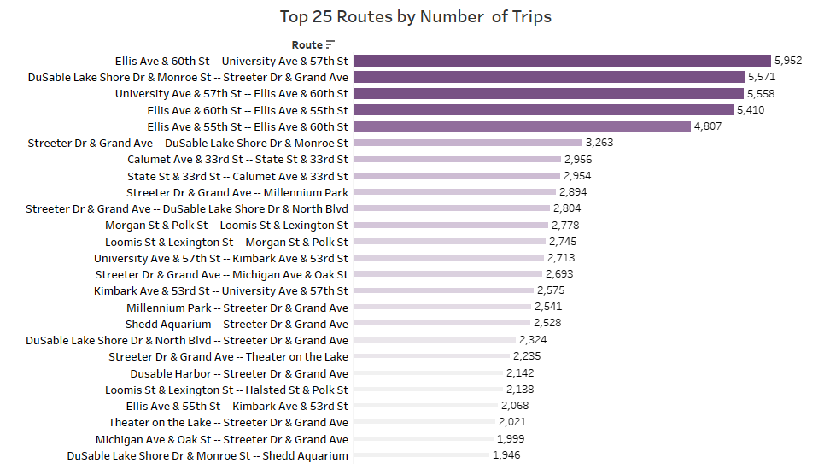
Top 25 Routes with the highest number of Trips
Ellis Ave & 60th St -- University Ave & 57th St is the most frequented route with
5952 trips.

Slide 13
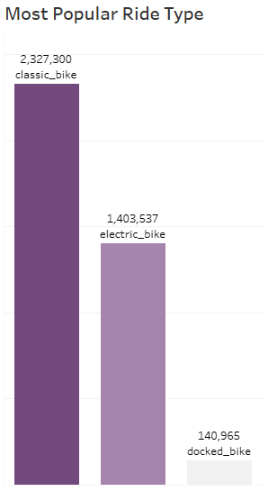
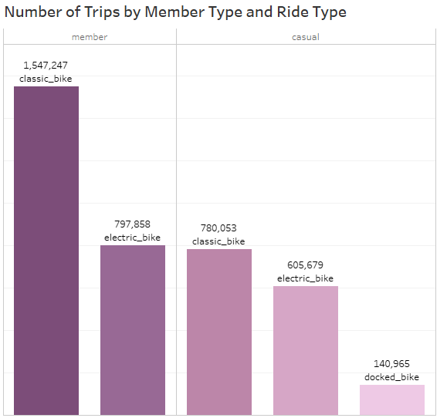
Over the last 11 months, the most popular ride type amongst users of Cyclist bike share was the Classic bike, which is also found to be the most popular choice among both Casual Users and Annual Subscribers.
Electric Bikes come second following the same pattern in both member types.
Docked bikes is the least frequently used bike type as only casual members make use of it.

Slide 14
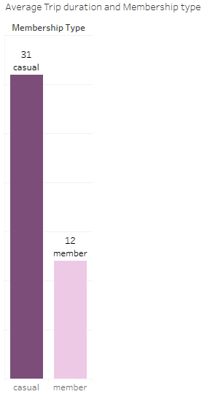
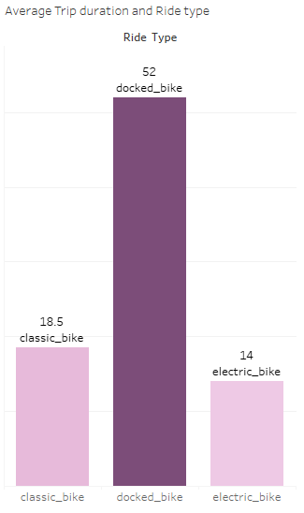
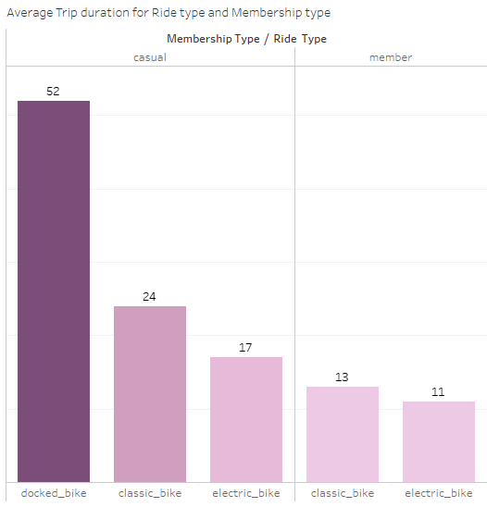
Further analysis reveals that on average casual riders have a longer trip length (31mins) than annual members(12mins).
Docked bikes have a higher average trip length (52mins) than other bike types but we can explain this because of lower number of users compared to annual members who do not use docked bikes. This leaves classic bikes(18.5mins) as the ride type with the higher average trip duration than electric bikes(14mins).
Grouping the average trip durations by Member type and Ride type, we can see a pattern that shows classic bikes having a higher trip duration in both member types than electric bikes. Docked bikes are only used by casual members.

Slide 15
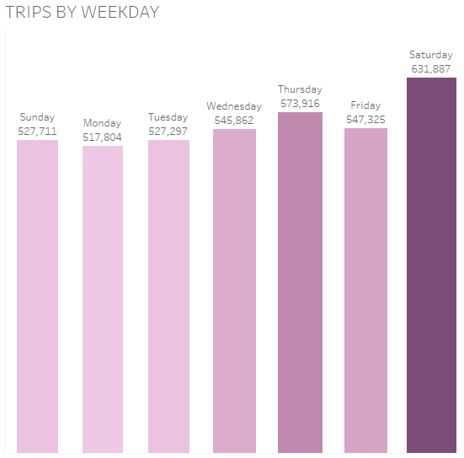
Looking at the number of trips by weekday, we can see a pattern of trips increasing as the week progresses taking a dip on Friday with Saturday having the highest number of trips being the beginning of the weekend.
Monday had the lowest number of trips.
We can further understand which ride types had more trips in the next slide.

Slide 16
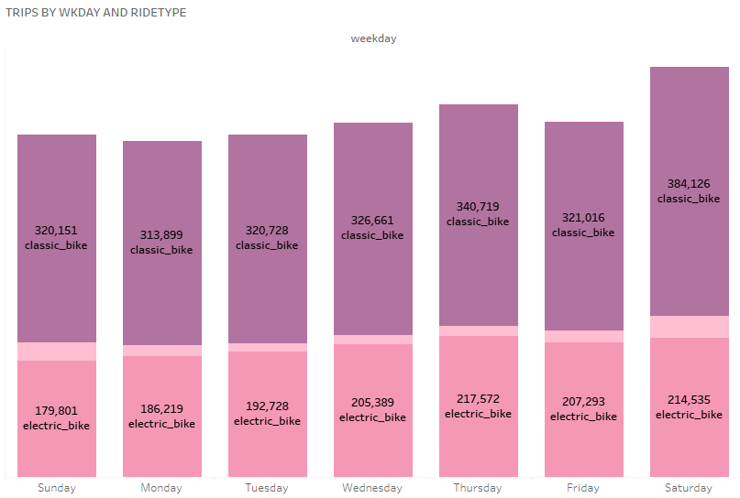
In our previous slide, we had a look at number of trips over the weekday. In this slide, we can breakdown each weekday by ride type to know which ride types were more popular for each week day.
As seen in the slide classic bikes were more used on the days with the highest number of trips ie Saturday and Thursday.
This is also quite true for Monday as well with Classic bikes significantly having more trips than electric and docked bikes.

Slide 17
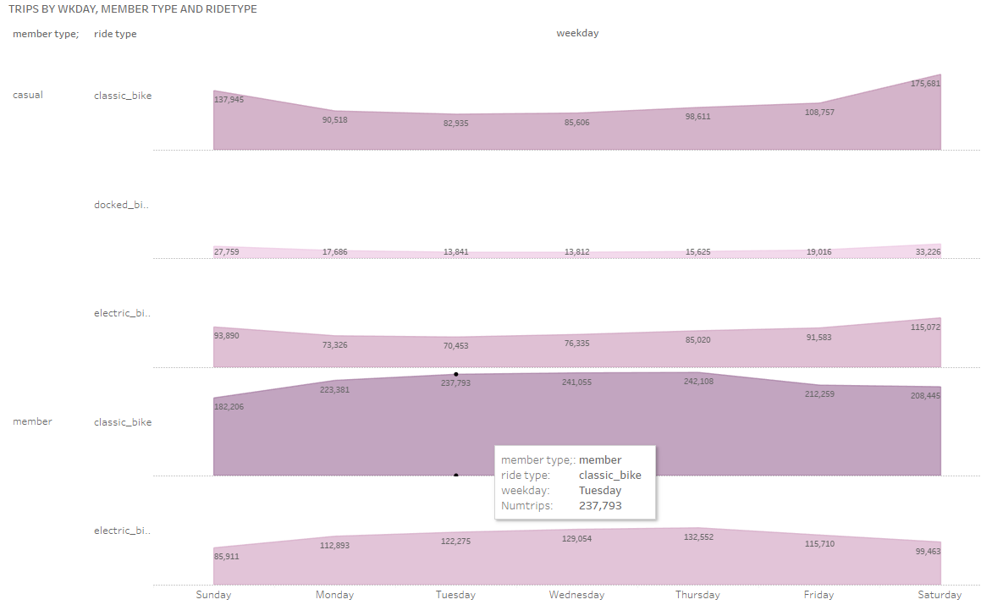
We now have a look at usage of bikes on a weekday basis by ride type and member type.
Following the trend we can notice a pattern for casual users, most of their rides peak on the weekends ie, Saturday and Sundar compared to Annual members who have more usage during weekdays with peak days from Tuesdays to Thurdays.
This is an interesting insight that shows varying distinct patterns in bike usage amongst the two groups of users across the week.

Slide 18
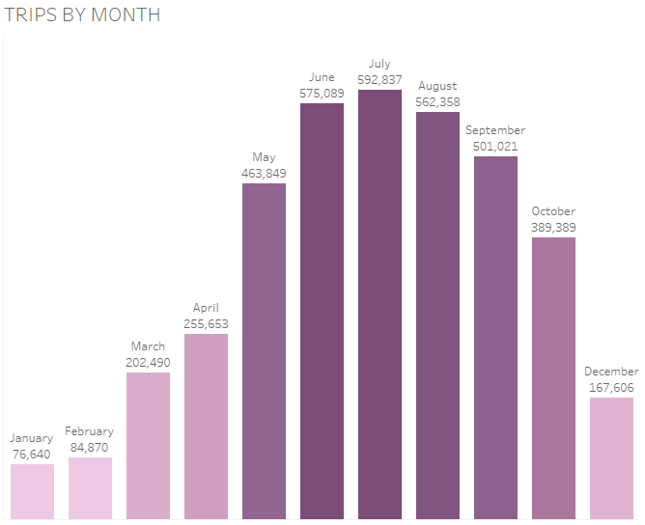
Analysis of the number of rides by month shows a peak usage during Summer with usage bottoming during the winter period.

Slide 19
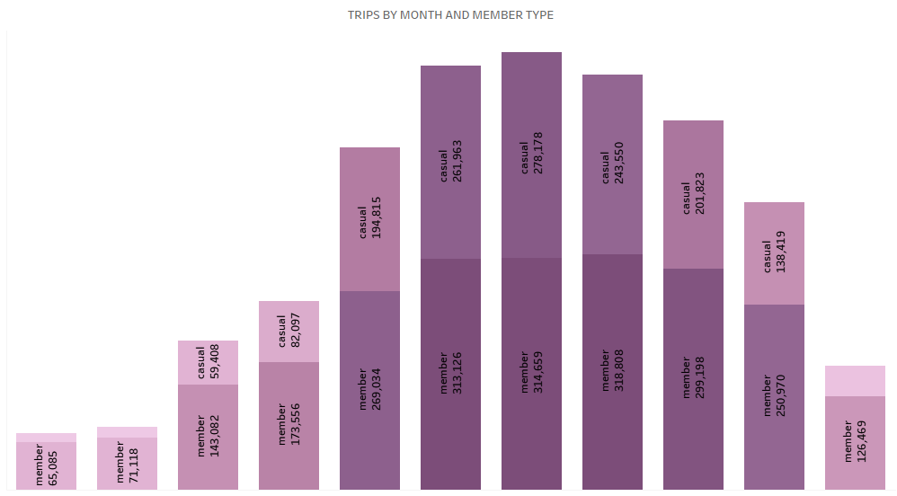
Further breakdown of number of rides by month we can reveal that annual members have the lion share of rides than casual users.

Slide 20
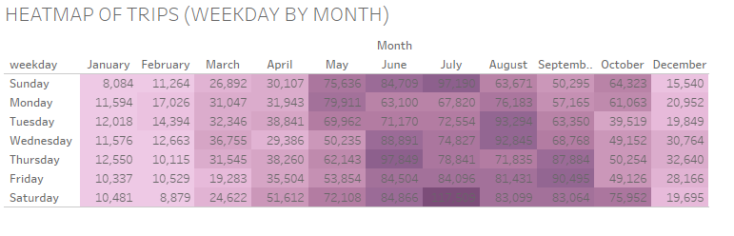

Slide 21
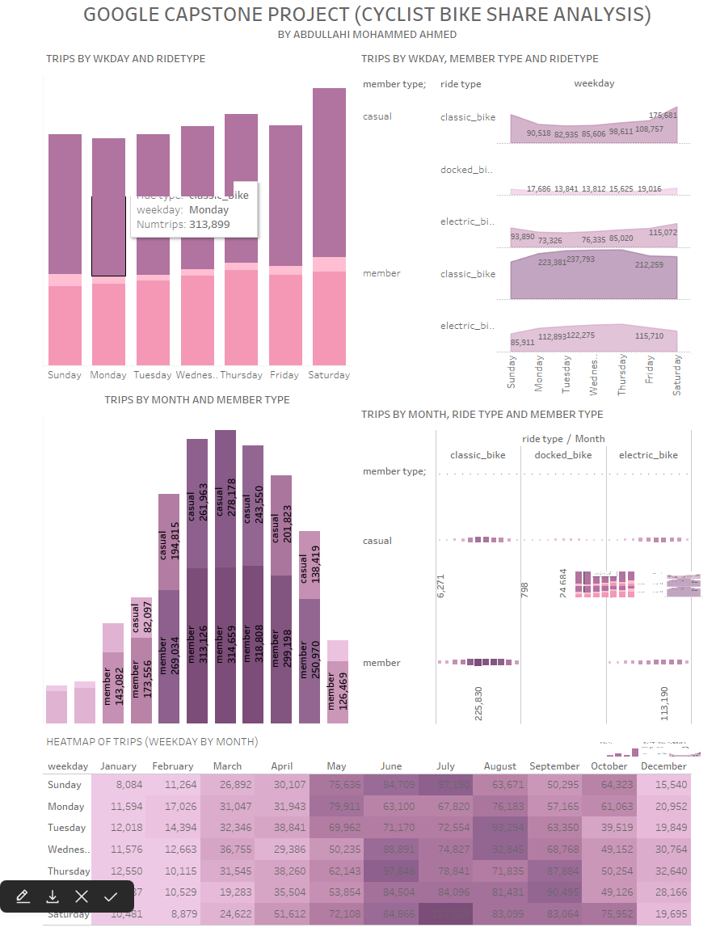
DASHBOARD
Link to Dashboard

Slide 22
CONCLUSION AND
RECOMMENDATIONS

Slide 23
Findings
Classic Bikes
Docked Bikes
Trip length
Classic bikes are a more popular choice amongst both types of users.
Annual Members do not use Docked bikes, this is a potential source of revenue. Making docked bikes available to annual members will increase revenue.
Casual members on average have more trip length than annual members.
Weekday Usage
Seasonal Pattern
Members Vs Casual
Casual users use the bikes more during the weekends compared to Users with annual membership who make more use of bike share during the week.
From the months May to September we see an uptrend of bike rides as these are the summer months. The bike usage dips during the winter months.
Annual members have more bike rides but lower average trip length than casual users.

Slide 24
Recommendations
Weekend Casual Riders
Summer Riders
Reward System
Weekends have more Casual riders so it makes sense to target marketing campaigns towards these casual riders with discounts on annual memberships.
The data shows summer has more influx of riders in causal members across the year.
Marketing should gear their efforts towards preparing campaigns towards these set of users before summer starts.
A reward system that gives discounts to member users should be enacted to entice more casual users.

Slide 25
Thank you!
Do you have any questions?
abdullahiahmedm@yahoo.com

